Slide 1


DEPARTMENT BES-1
  Course: Data Structures using Python
Course code: 24sc1204
    Topic: Mathematical background, Model
Session-01

Slide 2



AIM OF THE SESSION
To familiarize students with the basics of data structures, and algorithmic analysis to evaluate time complexities.
INSTRUCTIONAL OBJECTIVES
This Session is designed to:
Understand the concept of Data Structures.
Learn the Mathematical background and Model.
Analyse the algorithm to run time complexity.
LEARNING OUTCOMES
At the end of this session, you should be able to:
Evaluate the time complexities of the different Algorithmic solutions for various types of Problems.
Write the notations for calculating the running time complexity of different algorithms

Slide 3
SESSION INTRODUCTION
What is an Algorithm?
What is a Data Structure?
What is the complexity of an Algorithm?
Example of Time Complexity
What are the Different Notations?

Slide 4
ALGORITHM
A set of finite rules or instructions to be followed in calculations or other problem-solving operations
(or)
A procedure for solving a mathematical problem in a finite number of steps that frequently involves recursive operations
Set of rules to obtain the expected output from the given input
Input
Output
Algorithm
DATA STRUCTURE
Data Structures are used to store and organize the data in memory in an efficient manner
It is a way of arranging data on a computer to be accessed and updated efficiently.
Data Structure is used not only for organizing the data but also for processing, retrieving, and storing data.

Slide 5
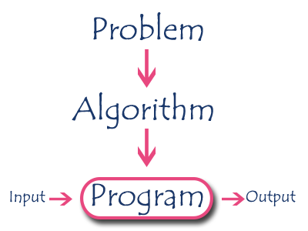
An algorithm is a step by step procedure to solve a problem. In normal language, the algorithm is defined as a sequence of statements which are used to perform a task.

Slide 6
Specifications of ALGORITHM
Every algorithm must satisfy the following specifications...
Input - Every algorithm must take zero or more number of input values from external.
Output - Every algorithm must produce an output as result.
Definiteness - Every statement/instruction in an algorithm must be clear and unambiguous (only one interpretation).
Finiteness - For all different cases, the algorithm must produce result within a finite number of steps.
Effectiveness - Every instruction must be basic enough to be carried out and it also must be feasible.

Slide 7
CLASSIFICATION OF DATA STRUCTURE
Data Structures are used to store and organize the data in memory in an efficient manner
It is a way of arranging data on a computer so that it can be accessed and updated efficiently.
Data Structure is not only used for organizing the data but also used for processing, retrieving, and storing data.

Slide 8
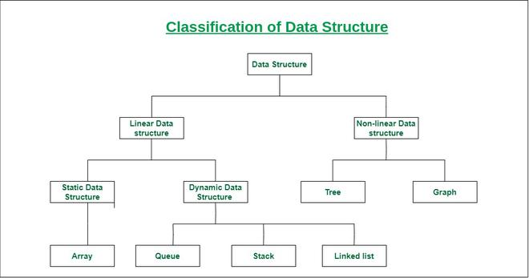
DATA STRUCTURES

Slide 9
PERFORMANCE ANALYSIS OF AN ALGORITHM
The performance of an algorithm depends on the following elements...
Whether that algorithm is providing the exact solution for the problem?
Whether it is easy to understand?
Whether it is easy to implement?
How much space (memory) it requires to solve the problem?
How much time it takes to solve the problem? Etc.,
“Performance analysis of an algorithm is the process of calculating space and time required by that algorithm”

Slide 10
COMPLEXITY OF AN ALGORITHM
Complexity in algorithms refers to the amount of resources (such as time or memory/Space) required to solve a problem or perform a task.
The most common measure of complexity is time complexity, which refers to the amount of time an algorithm takes to produce a result as a function of the size of the input.
Memory/Space complexity refers to the amount of memory used by an algorithm.

Slide 11
TIME COMPLEXITY
Time taken by the algorithm to solve the problem.
It is measured by calculating the iteration of loops, the number of comparisons etc.
Time complexity is a function describing the amount of time an algorithm takes in terms of the amount of input to the algorithm.
Example:
“Time” can mean:
The number of memory accesses performed,
The number of comparisons between integers,
The number of times some inner loop is executed, or
Some other natural units related to the amount of real-time the algorithm will take.

Slide 12
TIME COMPLEXITY COMPUTATION
def get_first(data):
return data[0]
if __name__ == '__main__':
data = [1, 2, 9, 8, 3, 4, 7, 6, 5]
print(get_first(data))
Ans: O(1)

Slide 13
SPACE COMPLEXITY
Suppose consider the following code:
def sum(x, y, z):
total = x + y + z;
return total;
In the above expression, variables total, x, y and z are all integer types, hence they will take up 4 bytes each, so the total memory requirement will be (4(4) + 4) = 20 bytes, this additional 4 bytes is for return value.

Slide 14
SUMMARY
Understand the concept of Data Structures.
Learn the Mathematical background and Model.
Analyse the algorithm to run time complexity.
Introduction about the Algorithm and Data Structure
Calculation of the Time and Space complexity of an algorithm to find out its efficiency

Slide 15
SELF-ASSESSMENT QUESTIONS
1. Identify the two types of efficiencies that are important for computer algorithms?
a) Time efficiency and Higher power efficiency
b) Higher power efficiency and Computational efficiency
c) Computational efficiency and Space efficiency
d) Space efficiency and Time Efficiency
2. What is the time complexity of accessing an element in an array by index?
A) O(n)
B) O(log⁡n)
C) O(1)
D) O(n2)

Slide 16
TERMINAL QUESTIONS
What is a data structure, and why is it important in computer science?
Differentiate between linear and non-linear data structures with examples.
How is time complexity measured?
Which of the following best describes the useful criterion for comparing the efficiency of algorithms?

Slide 17
REFERENCES FOR FURTHER LEARNING OF THE SESSION
Reference Books:
Sites and Web links:
  https://docs.python.org/3/tutorial/datastructures.html
  https://www.w3schools.com/dsa/dsa_intro.php
  https://www.geeksforgeeks.org/python-data-structures/
  https://onlinecourses.nptel.ac.in/noc25_cs59/preview
  https://www.coursera.org/learn/python-data
  https://www.codecademy.com/learn/learn-data-structures-and-algorithms-with-python
Data Structures and Algorithm Analysis in PYTHON, 2010, Mark Allen Weiss, Second Edition, Pearson Education.
Data Structures and Algorithms, A.V.Aho, J.E.Hopcroft, and J.D.Ullman, Pearson Education, First Edition Reprint2003.
Advanced Guide to Python 3 Programming, John Hunt, 4th Edition, Springer Nature Switzerland AG 2019.
Python Basics: A Practice Introduction to Python 3, David Amos, Dan Bader, Joanna Jablonski, Fletcher Heisler, 4th edition, Real Python.

Slide 18
THANK YOU
Team – Data Structures using Python

